Slide 1
What Is Frequent Pattern Analysis?
Frequent pattern: a pattern (a set of items, subsequences, substructures, etc.) that occurs frequently in a data set
First proposed by Agrawal, Imielinski, and Swami [AIS93] in the context of frequent itemsets and association rule mining
Motivation: Finding inherent regularities in data
  What products were often purchased together?— Beer and diapers?!
  What are the subsequent purchases after buying a PC?
  What kinds of DNA are sensitive to this new drug?
  Can we automatically classify web documents?
Applications
  Basket data analysis, cross-marketing, catalog design, sale campaign analysis, Web log (click stream) analysis, and DNA sequence analysis.

Slide 2
Why Is Freq. Pattern Mining Important?
Discloses an intrinsic and important property of data sets
Forms the foundation for many essential data mining tasks
  Association, correlation, and causality analysis
  Sequential, structural (e.g., sub-graph) patterns
  Pattern analysis in spatiotemporal, multimedia, time-series, and stream data
  Classification: associative classification
  Cluster analysis: frequent pattern-based clustering
  Data warehousing: iceberg cube and cube-gradient
  Semantic data compression: fascicles
  Broad applications

Slide 3
A Multidimensional View of Frequent Patten Discovery
others
types of data or knowledge
other interest measure
associative pattern
constraints
sequential pattern
pruning method
Sub-Graph pattern
compression method
closed/max pattern
iceberg cube
lattice transversal/ main operations
read
write
point

Slide 4
  本讲内容
关联规则
  基本概念
  Apriori 及其改进算法
  Apriori-based Sub-Graph Mining

Slide 5
Data and Knowledge Types
Associative Pattern
  transactional table vs relational table
  boolean vs quantitative
Sequential Pattern
  A sequence : < (ef) (ab) (df) c b >
  (e,f)->(a,b)-> c occur 50% of the time
Iceburg Cube
  table with a measures
TID | Items
10 | a, c, d
20 | b, c, e
30 | a, b, c, e
40 | b, e
TID | a | b | c | d | e
10 | 1 | 0 | 1 | 1 | 0
20 | 0 | 0 | 1 | 0 | 1
30 | 1 | 1 | 1 | 0 | 1
40 | 0 | 1 | 0 | 0 | 1
transactional=binary
Month | City | Cust_grp | Prod | Cost | Price
Jan | Tor | Edu | Printer | 500 | 485
Mar | Van | Edu | HD | 540 | 520
… | … | … | … | … | …
relational with quantitative attribute
Month | City | Cust_grp | Prod | Cost (Support)
Jan | Tor | * | Printer | 1040
… | … | … | … | …
cube: using other measure as support

Slide 6
Simulation of Lattice Transversal
a,b,c,e
The whole process of frequent pattern mining can be seen as a search in the lattice. Variety come in
Breadth first vs Depth first
Bottom up vs top down
Read-based, Write-Based, Pointer-Based
a,b,c
a,b,e
a,c,e
b,c,e
a,b
a,c
a,e
b,c
b,e
c,e
a
b
c
e
{}

Slide 7
Three categories of FPM Algorithms.
Read [AgSr94]
  Apriori-based. No write involved.
Write [Zaki00, HPY00, HaPe00]
  Perform write to improve performance.
Point [BeRa99, HPDW01]
  Memory based algorithm designed to point to various part of the data instead of re-writing the data in another part of the memory.

Slide 8
Generalized Framework
 | Read-based | Write-based | Point-based
Association Mining | Apriori[AgSr94] | FPGrowth [HaPe00]
Sub-Graph Mining | AGM[PKDD’00] FSG[ICDM’01] | Mofa[ICDM’02]
Sequential Pattern Discovery | GSP[AgSr96] | PrefixSpan [PHPC01]
Iceberg Cube | Apriori[AgSr94] |  | BUC[BeRa99], H-cubing [HPDW01]

Slide 9
关联规则
关联规则是发现交易数据库中不同商品（项）之间的联系
这些规则找出顾客购买行为模式
如购买了某一商品对购买其他商品的影响
发现这样的规则可以应用于商品货架设计、存货安排以及根据购买模式对用户进行分类。

Slide 10
example
“尿布和啤酒”
观察发现很多顾客在买尿布的时候同时也购买啤酒，这样超市把尿布和啤酒放在一起就可以提高销售额，如果把土豆片摆在它们中间，则会同时提高这三者的销售额。

Slide 11
Basic Concepts
规则: {x1，x2，…,xn}→Y
如果顾客把商品x1，x2，…, xn放入购物篮中的话，则很可能也会把商品Y放入其中。这个可能性（购买x1，x2，…,xn的前提下购买Y）称作规则的可信度，人们通常只对那些可信度大于某个值的规则感兴趣，希望把这些规则找出来。当然，有可能出现这样的情况，某些商品是被随机放入购物篮中的，例如：类似这样的规则，{牛奶，黄油}—〉面包，它的可信度非常大，可能是因为很多人都购买面包，象这样的规则是无用的。
可信度和最小可信度
购买x1，x2，…, xn 的情况下购买Y的可能性, 条件概率
支持度和最小支持度
同时购买x1，x2，…,xn 和Y的可能性
频繁项目集
满足最小支持度的项目集

Slide 12
支持度：
support (A ⇒ B ) = P(A ∪ B)
可信度：
confidence (A ⇒ B ) = P(B|A)

Slide 13
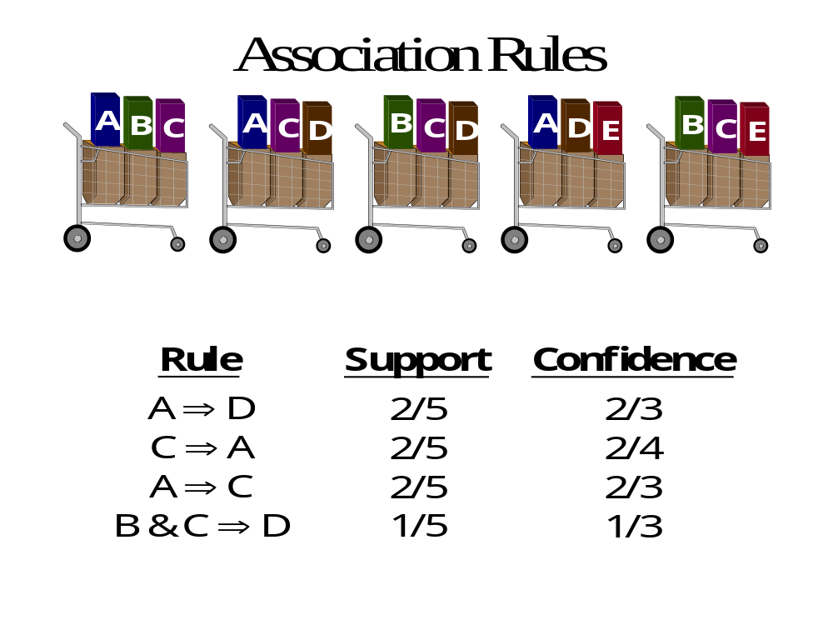

Slide 14
因果关系
理想情况下，人们都希望从关联规则中得出这样的结论，因为购买了商品x1，x2，…,xn，所以一定会购买商品Y。但是因果关系是一个很不好确定的东西，下面举一个例子来说明对购物篮数据来说，因果关系意味着什么。如果商店降低尿布的价格而升高啤酒的价格，则会吸引尿布购买者，而这些购买尿布的人同时很可能会购买啤酒，这样商店在尿布上遭受的损失就会从啤酒中得以弥补，这是因为“尿布是因，啤酒是果”。相反，如果降低啤酒的价格而升高尿布的价格，买啤酒的人多了但买尿布的人并不会增多，商店就赔本了。

Slide 15
Association Rule Mining:A Road Map
Based on the types of values
  Boolean AR, Quantitative AR
Based on the dimensions of data
  Single dimension, Multi-dimension
Based on the levels of abstractions
  Single level, Multi-level
Based on various extension
  Correlation analysis, Maxpatterns

Slide 16
Extension of AR Mining
Transaction Db
Relation，Data warehouse（OLAM ）
  Quantitative ，Multi-level，Cubegrade
Constrained AR
  Constrain on Item，Interest …
Correlation analysis

Slide 17
Evolution of AR Mining
1993: AIS（AR Model）
1994: Apriori（层次算法产生侯选集）
  1995 ：Partition，Hash-based，Parallel
  1996：Sample
  1997：Dynamic
2000:FP-Growth（不产生候选集 ）

Slide 18
How are association rule mined ?
两个子问题：
根据用户输入的最小支持度，寻找频繁项目集
2. 根据用户输入的最小可信度，产生关联规则
第二个问题比较简单，关键是解决第一个问题

Slide 19
Boolean AR：算法设计的重要前提
  以“市场-购物篮”为数据模型，把数据看作一个布尔
  矩阵，其中行=购物篮，列=商品项目：
  矩阵很稀疏，几乎全是0
  列的数目（项目数）要足够小，每列存点东西的话可以把所有的列放入内存，同时列的数目又要足够大，每个项目对存点东西的话不能全部放入内存。
  行的数目很多，不可能把整个矩阵放入内存，即使利用稀疏采用压缩也不行。

Slide 20
item TID | a | b | c | d | e
T100 | 1 | 0 | 1 | 0 | 0
T200 | 1 | 1 | 1 | 0 | 0
T300 | 1 | 0 | 0 | 1 | 1
T400 | 0 | 0 | 1 | 0 | 1
T500 | 1 | 0 | 1 | 1 | 1
T600 | 0 | 1 | 1 | 1 | 0
T700 | 1 | 0 | 1 | 0 | 0

Slide 21
怎样估计算法运行的时间？
主要考虑：
它对数据的扫描次数 数据挖掘的主要代价是从硬盘读数据，因此估算一个数据挖掘算法运行时间的最好手段是看它对同一个数据读了几次。

Slide 22
重要的公理
如果一个项目集S是频繁的（项目集S的出现
频度大于最小支持度s），那么S的任意子集
也是频繁的。

Slide 23
要找出频繁项目集，主要有两类算法：
分层挖掘 （每一层需要对数据做一次扫描。 ）
先找出大小为1的频繁项目集，再找出大小为2的频繁项目集，再找出大小为3的频繁项目集，等等。
我们只需要把精力放在大小为2的频繁项目集上，因为：
  通常，大小为2的频繁项目集就足够了。
  在很多数据集合里，查找大小为2的频繁项目集比较困难，进行高层挖掘比查找大小为2的频繁项目集用的时间要少。
2. 数据做一次（最多两次）扫描，找出最大频繁集 （任何超集都不是频繁集的集合S）。

Slide 24
  本讲内容
关联规则
  基本概念
  Apriori 及其改进算法
  Apriori-based Sub-Graph Mining

Slide 25
Apriori 算法步骤1：分层寻找频繁项目集
  给出minisupp，第一次扫描数据的时候，找出频度大于minisupp的项目，称这集合为L1。一般来说，一个商店卖的商品品种不会超过10万个，所以我们假定有足够的内存来计算每个项目的出现频度。
  第二次扫描数据时，L1中的项目对成为大小为2的候选项目集C2，我们希望C2不要太大，这样的话就可以有足够的空间为每个候选对分配一个计数器来计算它的出现频度，计数值大于minisupp的候选对构成大小为2的频繁项目集L2。
  第三次扫描数据时，由L2生成大小为3的候选项目集C3，C3是这样的集合{A，B，C}，并且{A，B}，{B，C}，{A，C}都在L2中。计算C3中每个三元组的出现频度，大于minisupp构成L3。
  一直进行到集合为空时为止。Li是大小为i的频繁项目集，Ci+1是大小为i+1的集合，这些集合的每个大小为i 的子集都在Li中。

Slide 26
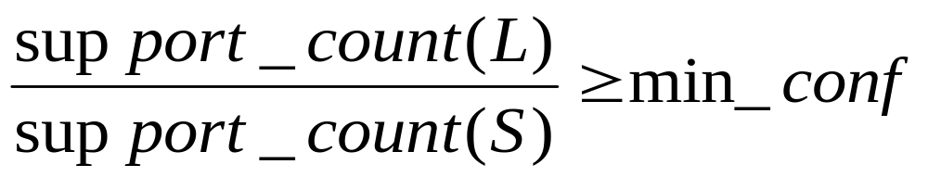
Apriori 算法步骤2: 产生关联规则
对于每个频繁项目集L，产生它的所有非空子集S
对L的每个非空子集S，如果满足如下条件：
则输出关联规则 S→(L – S)

Slide 27
The Apriori Algorithm
a,b,c,e
Bottom-up, breadth first search
Only read is perform on the databases
Store candidates in memory to simulate the lattice search
Iteratively follow the two steps:
  generate candidates
  count and get actual frequent items
b,c,e
b,c,e
a,b,c
a,b,e
a,c,e
b,c,e
a,b
a,c
a,e
b,c
b,e
c,e
a,c
b,c
b,e
c,e
a,b
a,c
a,e
b,c
b,e
c,e
a
b
c
e
a
b
c
e
a
b
c
e
start
{}

Slide 28
Candidate Generation and Pruning
Suppose all frequent (k-1) items are in L_{k-1}
Step 1: Self-joining L_{k-1}
  insert into C_{k}
  select p.i₁, p.i₂, …, p.i_{k-1}, q.i_{k-1}
  from L_{k-1} p, L_{k-1} q
  where p.i₁=q.i₁ , … , p.i_{k-2}=q.i_{k-2} , p.i_{k-1} < q.i_{k-1}
a,b,c,e
Step 2: pruning
  forall itemsets c in C_{k} do
  forall (k-1)-subsets s of c do if (s is not in L_{k-1}) then
  delete c from C_{k}
b,c,e
b,c,e
b,c,e
a,b,c
b,c,e
a,b,c
a,b,c
a,b,c
a,b,e
a,c,e
a,b
a,c
a,e
b,c
b,e
c,e

Slide 29
Candidate Generation and Pruning(another example)
a,b,c,e
a,b,c,e
a,b,c,e
a,b,c,e
a,b,c
a,b,e
a,c,e
b,c,e

Slide 30
The Apriori Algorithm—An Example
Sup_{min} = 2
Itemset | sup
{A} | 2
{B} | 3
{C} | 3
{D} | 1
{E} | 3
Database TDB
Itemset | sup
{A} | 2
{B} | 3
{C} | 3
{E} | 3
L₁
Tid | Items
10 | A, C, D
20 | B, C, E
30 | A, B, C, E
40 | B, E
C₁
1st scan
C₂
Itemset | sup
{A, B} | 1
{A, C} | 2
{A, E} | 1
{B, C} | 2
{B, E} | 3
{C, E} | 2
C₂
L₂
Itemset
{A, B}
{A, C}
{A, E}
{B, C}
{B, E}
{C, E}
Itemset | sup
{A, C} | 2
{B, C} | 2
{B, E} | 3
{C, E} | 2
2nd scan
C₃
Itemset
{B, C, E}
3rd scan
L₃
Itemset | sup
{B, C, E} | 2

Slide 31
Important Details of Apriori
How to generate candidates?
  Step 1: self-joining L_{k}
  Step 2: pruning
How to count supports of candidates?
Example of Candidate-generation
  L₃={abc, abd, acd, ace, bcd}
  Self-joining: L₃*L₃
    abcd from abc and abd
    acde from acd and ace
  Pruning:
    acde is removed because ade is not in L₃
  C₄={abcd}

Slide 32
对A-priori算法的改进
当>=2时,减小候选集Ci的大小.这一点非常重要,因为即使对于找频繁的对(大小为2的频繁项目集),候选集的大小必须足够小,给每个对加一个计数器之后还可以在内存中放得下.
（基于hash的算法以及Iceberg 查询对hash算法的改进）
2. 把找L1,L2,…,Ln的过程合并成一次(最多两次)扫描,而不是每层扫描一次.
（Sample算法，Partition算法，Dynamic算法）
3. 减小数据库的大小
任何一个事务（一个购物蓝），如果它不包含
k-itemset，则不包含k+1-itemset，可以去掉。
（基于hash的算法采用了该技术）

Slide 33
基于hash的算法
利用了内存通常比项目数要大的事实,在第一次扫描数
据决定L1的时候，建立一个哈希表（P237），根据该
表的数据来提前去掉那些不可能是频繁的2-itemset.
在第一次开始扫描数据决定L1时，内存中的情况如图：
Counter for item
Hash table

Slide 34
基于hash的算法: pass 1
计算所有项目的频度
对每一个记录，将所有的 2-Itemset 哈希到哈希表的某个桶中,桶的计数增加1
扫描结束时，将频度大于s的项目放入L1.
扫描结束时，找出哈希表中计数值大于s的桶（在结果位图中，相应位设为1）。

Slide 35
在第二次扫描数据决定L2时，内存中的情况如图：
Frequent items
Bitmap
Counter for candidate 2-Itemset

Slide 36
基于hash的算法: pass 2
内存中存放有大小为1的频繁项目集L1。
内存中存放有位图
最后，内存中还放了一个表，存放所有的候选对和它们的计数值，候选对集合C2中的每一个对（i，j），必须满足下列条件：
  i 在L1中，j 在L1中
  对（i，j）必须哈希到一个频繁桶中
  第二点正是PCY算法和直接a-priori算法之间的不同之处。PCY算法
  减小了第二次扫描数据时的内存需求。
4. 最后，在第二次扫描数据时，考察每一个2-Itemset，如果满足上面列出的两个条件，则在内存中增加它的计数值，如果第一次出现的话创建一个入口点。

Slide 37
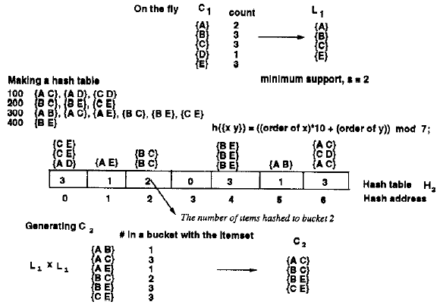
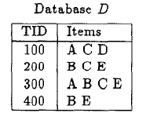
An example
Items | Order
A | 1
B | 2
C | 3
D | 4
E | 5

Slide 38
什么时候Hash算法比Apriori 算法优越？
当C2很大（C2和他们的计数器在内存中放不下），而Hash算法产生的频繁桶却很少（大大地减小了C2的大小，使之能全部装入内存,从而不需要再扫描数据）时，Hash算法比Apriori算法优越。

Slide 39
partition算法 (two passes)
将数据划分成多个子集, 分别读入内存，找出局部候
选集(pass 1)
再次扫描数据，找出所有的频繁集.(pass 2)
关键点: 一个集合如果在任一个子集中都不频繁，则
它在全局数据中也不频繁

Slide 40
Sample算法( one or two passes)
随机取内存大小的一个数据的样本，在内存中运行一个层次算法（不用负担I/O），希望从这个样本数据能求出真正的频繁集
  按比例伸缩最小支持率，如果样本数据是整个数据的1%，则应该用s%作为新的最小支持率
  完整地扫描数据一次，对由样本数据得出的频繁项目集进行验证，但是那些在全局数据中频繁但在样本数据中不频繁的集合被丢掉了
  为了减小false negative，可以将样本数据的最小支持率降低一点，这样在全面扫描数据的时候就可以找到更多的候选集。但注意：这样做的后果可能会产生太多的候选集而使内存装不下。

Slide 41
Bottleneck of Frequent-pattern Mining
Multiple database scans are costly
Mining long patterns needs many passes of scanning and generates lots of candidates
  To find frequent itemset i₁i₂…i₁₀₀
    # of scans: 100
    # of Candidates: (₁₀₀¹) + (₁₀₀²) + … + (₁¹₀⁰₀⁰) = 2¹⁰⁰-1 = 1.27*10³⁰ !
Bottleneck: candidate-generation-and-test
Can we avoid candidate generation?

Slide 42
So far, we covered
 | Read-based | Write-based | Point-based
Association Mining | Apriori[AgSr94] | FPGrowth [HaPe00]
Sequential Pattern Discovery | GSP[AgSr96] | PrefixSpan [PHPC01]
Sub-Graph Mining | AGM[PKDD’00] FSG[ICDM’01] | Mofa[ICDM’02] gSpan[ICDM’02]
Iceberg Cube | Apriori[AgSr94] |  | BUC[BeRa99], H-cubing [HPDW01]

Slide 43


Slide 44
  本讲内容
关联规则
  基本概念
  Apriori 及其改进算法
  Apriori-based Sub-Graph Mining

Slide 45
Graph Mining
Graphs are ubiquitous
  Web databases, XML databases
  Cheminformatics (chemical compound)
  Bioinformactics (protein structure, pathway)
  Workflow analysis
  Social network analysis
Graph is a general model
  Trees, lattices, sequences, and items are degenerated graphs
  Graph algorithms: many have high complexity
Diversity of graphs
  Directed vs. undirected, labeled vs. unlabeled (edges and vertices), angles/geometry, weighted edges

Slide 46
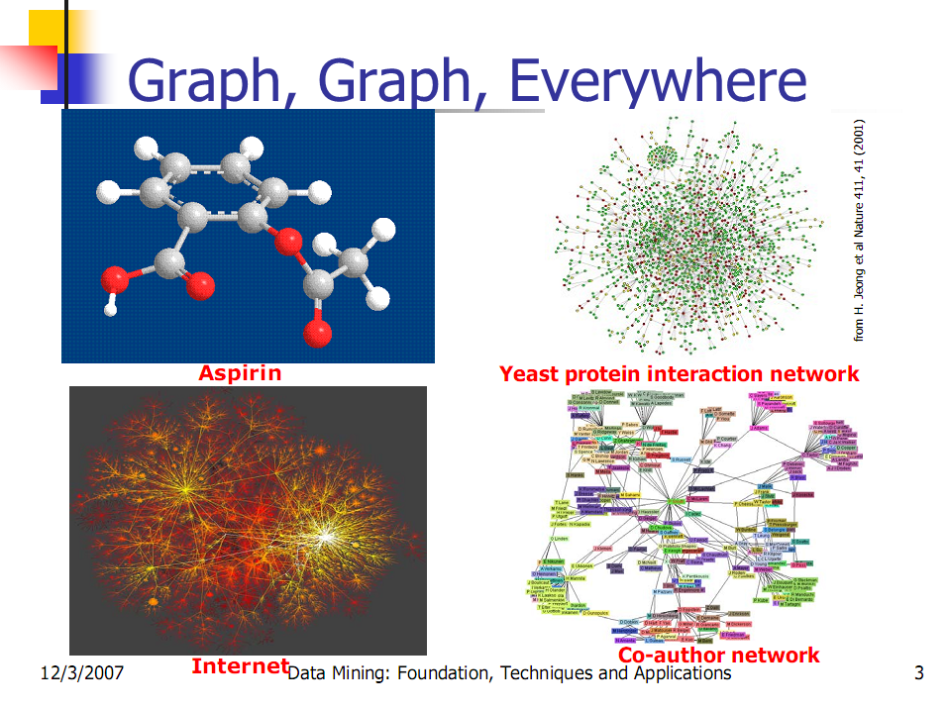

Slide 47
Frequent Graph Pattern Mining
Frequent subgraphs
  A (sub)graph is frequent if its support in a given dataset is no less than a minimum support threshold
Applications
  Mining biochemical structures
  Mining XML structures or Web communities
  Trees, lattices, sequences, and items are degenerated graphs

Slide 48
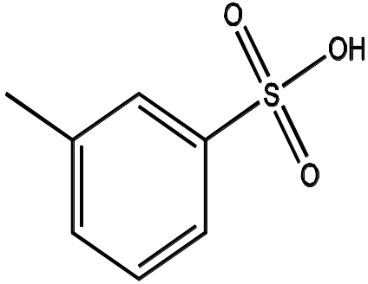
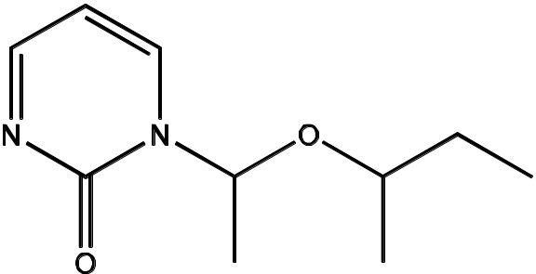
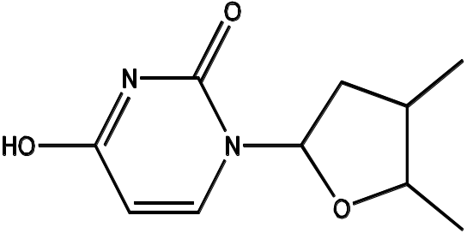
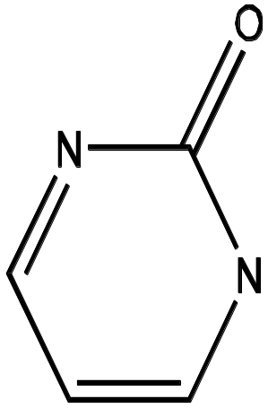
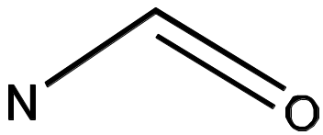
Example (Chemistry-informatics)
Graph Dataset
(A)
(B)
(C)
Frequent Patterns
(min support is 2)
(1)
(2)

Slide 49
Related Work
AGM/AcGM: Inokuchi, et al. (PKDD’00)
FSG/FSG2: Kuramochi, et al. (ICDM’01)
Vanetik, et al. (ICDM’02)
Borgelt, et al. (ICDM’02)
gSpan: Yan and Han (ICDM’02)
…

Slide 50
Subgraph Explosion Problem
An n-edge frequent graph may have 2^{n} subgraphs. All of them are frequent too.
Among 422 chemical compounds which are confirmed to be active in an AIDS antiviral screen dataset, there are 1,000,000 frequent graph patterns if the minimum support is 5%

Slide 51
Observation
If a graph is frequent, all of its subgraphs are frequent ─ the Apriori property
If some of its subgraphs have the same support, it is unnecessary to output these subgraphs (closed graphs): This still ensures the mining result is complete—“lossless compression”

Slide 52
Example
Graph Dataset
(A)
(B)
(C)
Frequent Patterns
(min support is 2)
(1)
(2)

Slide 53
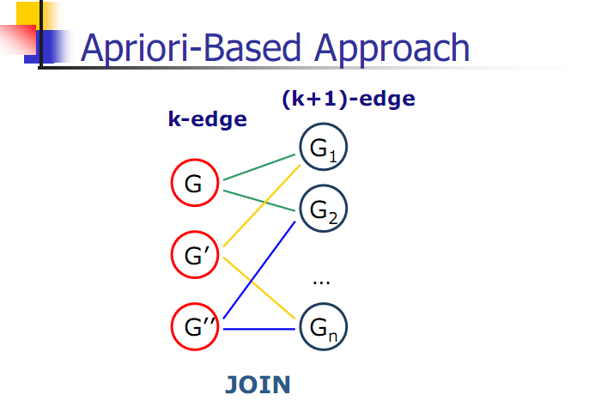

Slide 54

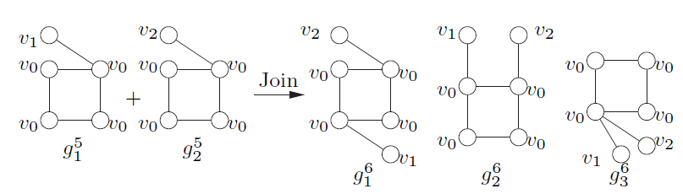
Apriori-based， BFS
Methodology：Breadth-search，joining two graphs
AGM（Inokuchi, et al. PKDD’00）,generates new graphs with one more node
FSG(Kuramochi and Karypis ICDM’01), generates new graphs with one more edge

Slide 55
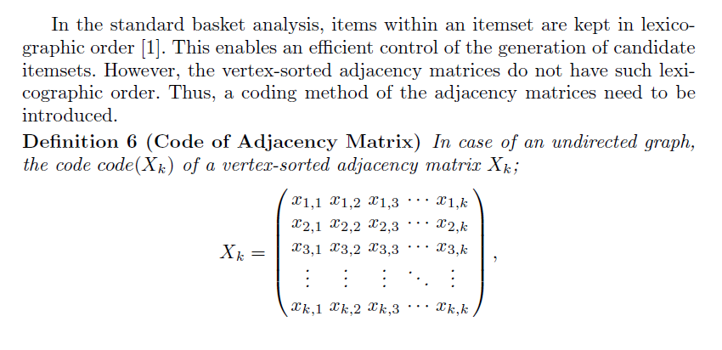
AGM
无向图code:
有向图code:

Slide 56
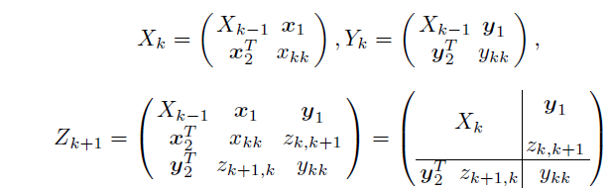
AGM

Slide 57
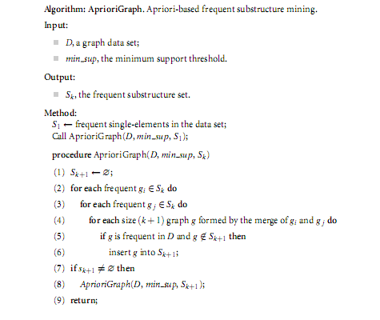

Slide 58
So far, we covered
 | Read-based | Write-based | Point-based
Association Mining | Apriori[AgSr94] | FPGrowth [HaPe00]
Sub-Graph Mining | AGM[PKDD’00] FSG[ICDM’01] | Mofa[ICDM’02]
Sequential Pattern Discovery | GSP[AgSr96] | PrefixSpan [PHPC01]
Iceberg Cube | Apriori[AgSr94] |  | BUC[BeRa99], H-cubing [HPDW01]

Slide 59
References
[AgSr94] R. Agrawal, R. Srikant, “Fast Algorithms for Mining Association Rules”, Proc. of the 20th Int'l Conference on Very Large Databases, Santiago, Chile, Sept. 1994.
[AgSr96] R. Srikant, R. Agrawal: "Mining Sequential Patterns: Generalizations and Performance Improvements", to appear in Proc. of the Fifth Int'l Conference on Extending Database Technulogy (EDBT), Avignon, France, March 1996.
[BeRa99] Kevin S. Beyer and Raghu Ramakrishnan. “Bottom-Up Computation of Sparse and Iceberg CUBEs”. In Proceedings of the ACM SIGMOD International Conference on Management of Data, pages 359-370, June 1999.
[HPDW01] J. Han, J. Pei, G. Dong, and K. Wang, “Efficient Computation of Iceberg Cubes with Complex Measures”, Proc. 2001 ACM-SIGMOD Int. Conf. on Management of Data (SIGMOD'01), Santa Barbara, CA, May 2001.
[HPY00] J. Han, J. Pei, and Y. Yin, `` Mining Frequent Patterns without Candidate Generation'',, Proc. 2000 ACM-SIGMOD Int. Conf. on Management of Data (SIGMOD'00), Dallas, TX, May 2000.
[HaPe00] J. Han and J. Pei ``Mining Frequent Patterns by Pattern-Growth: Methodology and Implications '', ACM SIGKDD Explorations (Special Issue on Scaleble Data Mining Algorithms), 2(2), December 2000.
[PHPC01] J. Pei, J. Han, H. Pinto, Q. Chen, U. Dayal, and M.-C. Hsu, “ PrefixSpan: Mining Sequential Patterns Efficiently by Prefix-Projected Pattern Growth'', Proc. 2001 Int. Conf. on Data Engineering (ICDE'01), Heidelberg, Germany, April 2001.

Slide 60
References
[SHSB00] P.Shenoy, J. Haritsa, S. Sudarshan, G. Bhalotia, M. Bawa, D. “Turbo-Charging Vertical Mining of Large Database.” Proc. 2000 ACM-SIGMOD Int. Conf. on Management of Data (SIGMOD'00), Dallas, TX, May 2000.
[Zaki98] Mohammed J. Zaki, “Efficient Enumeration of Frequent Sequences”, 7th International Conference on Information and Knowledge Management, pp 68-75, Washington DC, November 1998.
[Zaki00] Mohammed J. Zaki, “Scalable Algorithms for Association Mining”, in IEEE Transactions on Knowledge and Data Engineering, Vol. 12, No. 3, pp 372-390, May/June 2000.
[Zaki01] Mohammed J. Zaki, “SPADE: An Efficient Algorithm for Mining Frequent Sequences”, in Machine Learning Journal, special issue on Unsupervised Learning (Doug Fisher, ed.), pp 31-60, Vol. 42 Nos. 1/2, Jan/Feb 2001.
An Apriori-based Algorithm for Mining Frequent Substructures from Graph Data
Frequent Subgraph Discovery

